Slide 1
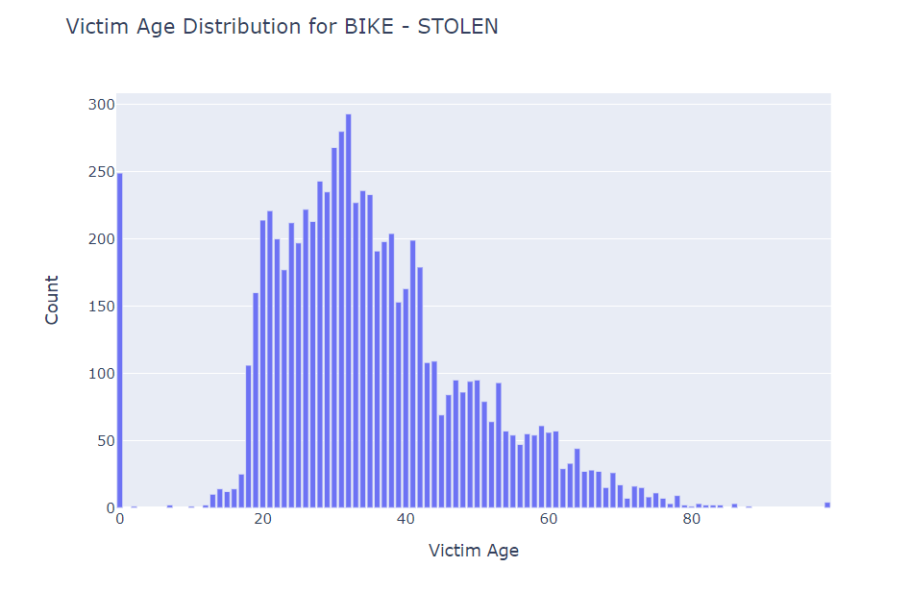
Julen Marmol - Crime Data from 2020 to Present In LA
Victim Age Distribution for Stolen bicycles in LA
Source:
https://data.lacity.org/Public-Safety/Crime-Data-from-2020-to-Present/2nrs-mtv8/about_data
Query:
db.LA_crimes_since_2020.aggregate([{$match: {CrimeDescription: "BIKE - STOLEN" } }, {$group:{_id: "$VictimAge", count: {$sum: 1}}}, {$sort: {_id: 1}}]);

